Slide 1
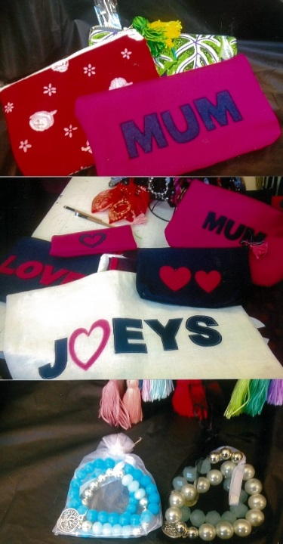
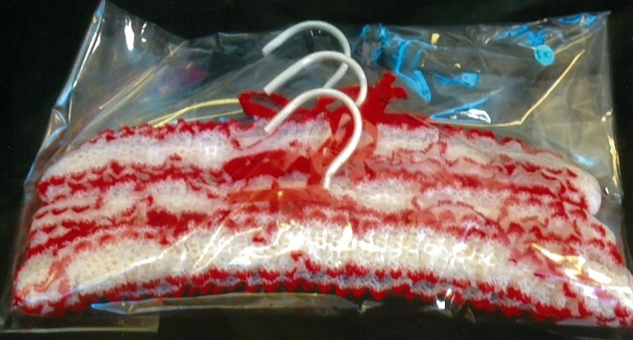
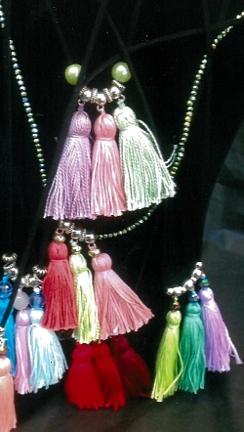
Mother’s Day Stall
Thursday 11 May - Recess & Lunch
Friday 12 May - Recess Only
STALL WILL BE LOCATED Outside THE Farrell Auditorium
Gifts: $10, $15 and $20
Students and staff welcome

